Slide 1
PRIVILEGED AND NON- PRIVILEGED INSTRUCTIONS

Slide 2
Operating System : Operating System is defined as a collection of programs that coordinates the operations of computer hardware and software.
It acts as a bridge for the interface between man and machine.
Examples of Operating System are: Windows Linux BOSS etc.
Kernel is central component of an operating system that manages operations of computer and hardware.
It basically manages operations of memory and CPU time. It is core component of an operating system.
Kernel acts as a bridge between applications and data processing performed at hardware level using inter-process communication and system calls.

Slide 3
Kernel loads first into memory when an operating system is loaded and remains into memory until operating system is shut down again.
It is responsible for various tasks such as disk management, task management, and memory management.
Kernel has a process table that keeps track of all active processes
• Process table contains a per process region table whose entry points to entries in region table.
Kernel loads an executable file into memory during ‘exec’ system call’.

Slide 4
It decides which process should be allocated to processor to execute and which process should be kept in main memory to execute.
It basically acts as an interface between user applications and hardware.
The major aim of kernel is to manage communication between software i.e. user-level applications and hardware i.e., CPU and disk memory.
Objectives of Kernel :
To establish communication between user level application and hardware.
To decide state of incoming processes.
To control disk management.
To control memory management.
To control task management.

Slide 5
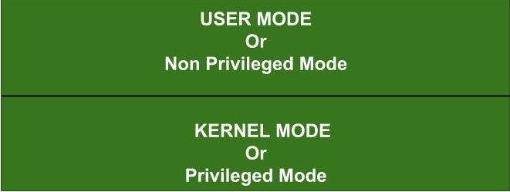
In any Operating System, it is necessary to have a Dual Mode Operation to ensure the protection and security of the System from unauthorized or errant users. This Dual Mode separates the User Mode from the System Mode or Kernel Mode.

Slide 6
What are Privileged Instructions?
The Instructions that can run only in Kernel Mode are called Privileged Instructions .
Privileged Instructions possess the following characteristics :
If any attempt is made to execute a Privileged Instruction in User Mode, then it will not be executed and treated as an illegal instruction. The Hardware traps it in the Operating System.
(ii) Before transferring the control to any User Program, it is the responsibility of the Operating System to ensure that the Timer is set to interrupt. Thus, if the timer interrupts then the Operating System regains the control.
Thus, any instruction which can modify the contents of the Timer is Privileged Instruction.
(iii) Privileged Instructions are used by the Operating System in order to achieve correct operation.

Slide 7
(iv) Various examples of Privileged Instructions include:
I/O instructions and Halt instructions
Turn off all Interrupts
Set the Timer
Context Switching
Clear the Memory or Remove a process from the Memory
Modify entries in the Device-status table

Slide 8
What are Non-Privileged Instructions?
The Instructions that can run only in User Mode are called Non-Privileged Instructions .
Various examples of Non-Privileged Instructions include:
Reading the status of Processor
Reading the System Time
Generate any Trap Instruction
Sending the final printout of Printer
Also, it is important to note that in order to change the mode from Privileged to Non-Privileged, we require a Non-privileged Instruction that does not generate any interrupt.

